Slide 1
Maximising the Benefits of Research and Innovation: Establishing and developing the Cheshire and Merseyside Integrated Research and Innovation System (IRIS)

Slide 2
In this session we will:
Share the ICBs Constitution and discuss how Research & Innovation as a main cross cutting theme fits with the principles of C&M ICB
Introduce Maximising the Benefits of Research: Guidance for Integrated Care Systems
Share the progress made with IRIS including the following; support for ICB priorities, its role in attracting investment and how we plan to contribute to developing a world-class research and innovation system
Introduction to the CIVIC Health Innovation Labs (CHIL) and the rationale for adoption by IRIS
Group Q&A

Slide 3
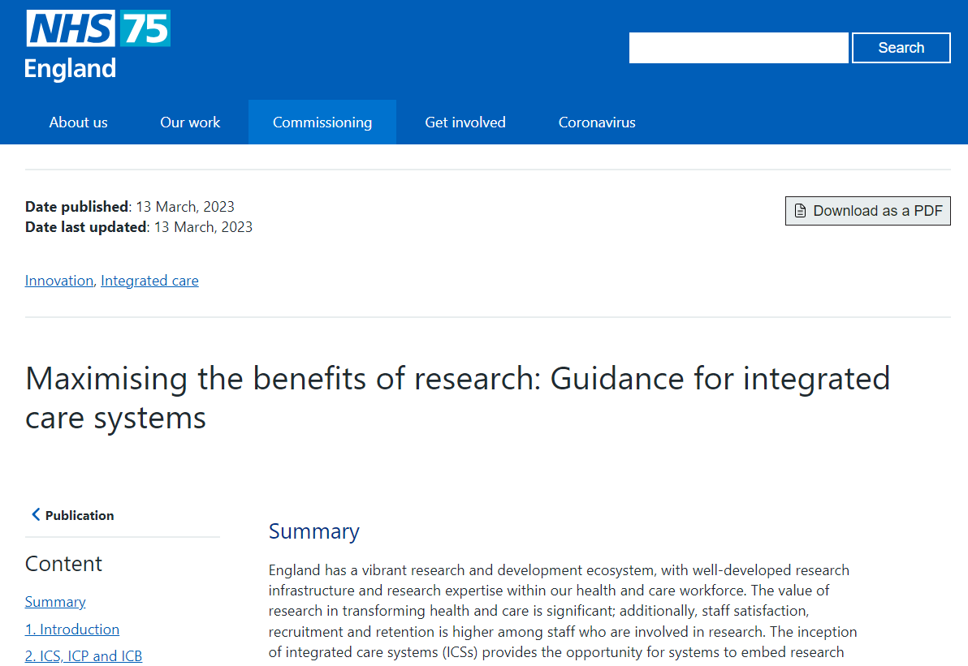

Slide 4
Maximising the benefits of research:
ICSs are encouraged to develop a research strategy that aligns to or could be included in their integrated care strategy.
Identify and address local research priorities and needs, and work collaboratively to address national research priorities
Improve the quality of health and care and outcomes for all through the evidence generated by research
Increase the quality, quantity and breadth of research undertaken locally
Extend and expand research in settings such as primary care, community care, mental health services, public health and social care
Drive the use of research evidence for quality improvement and evidence-based practice
Influence the national research agenda to better meet local priorities and needs
Improve co-ordination and standardisation within and between localities for the set up and delivery of research
Harness the patient and economic benefits of commercial contract research
Co-ordinate and develop the research workforce across all settings.

Slide 6
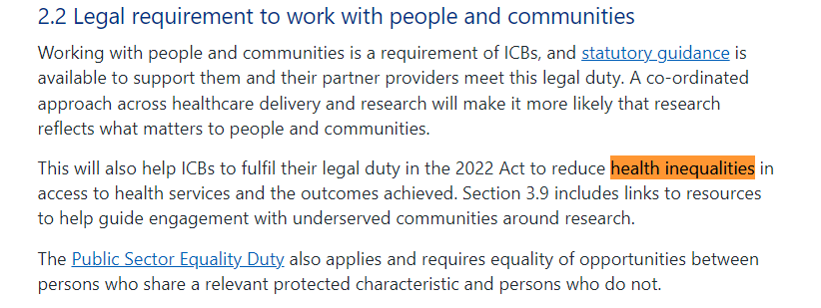

Slide 7
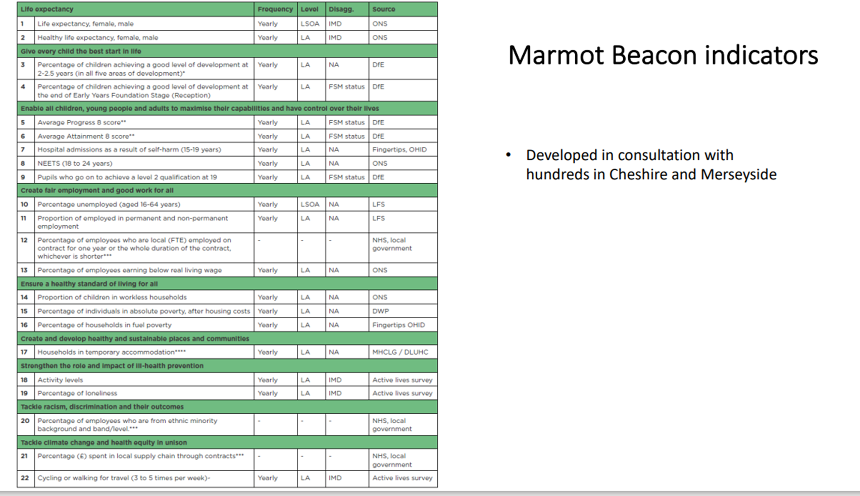

Slide 8
What is the C&M Integrated Research and Innovation System (IRIS): The primary aim of IRIS is to create a research and innovation driven healthcare ecosystem that benefits the entire population by fostering research and innovation excellence to improve the health and wellbeing of the population of Cheshire and Merseyside and further afield. IRIS will identify, address, and prioritise local and national research and innovation needs and priorities. This will lead to improved healthcare outcomes, the promotion of evidence-based practices, expanded research efforts, and enhanced collaboration across the healthcare system.

Slide 9
What will IRIS do: 1. Collate and Convene Stakeholders 2. Research and Innovation Planning 3. Identify and Address Research and Innovation Priorities 4. Influence the National and International Research and Innovation Agenda 5. Expand Research and Innovation 6. Promote Evidence Based Practice 7. Harmonise and Coordinate Research and Innovation Activities 8. Cultivate a learning environment 9. Leverage Commercial Contract Research and Innovation 10. Develop the Research and Innovation Workforce and Infrastructure 11. Sustainability 12. Improve Healthcare and Outcomes

Slide 10
A civic partnership advancing health, social and economic wellbeing together through system-wide data and health technology research and innovation
www.liverpool.ac.uk/chil
chil@liverpool.ac.uk
@LivUniCHIL
Tackling global health challenges with civic data and innovation

Slide 11
Civic partnership of academia, local government and NHS mobilising data and technology to tackle wicked problems with and for our residents…
Launched December 2023
"Collaboration within the research sector is essential if we want to tackle some of the largest health and care problems facing the world today, and centres like this make that a reality"
Professor Lucy Chappell
Chief Scientific Adviser to DHSC and Chief Executive Officer of NIHR

Slide 12
The Centre’s Purpose
We are an interdisciplinary research and innovation centre dedicated to inclusive health, social and economic advancement through civic data and technologies
We serve our population by improving health, social and economic outcomes with trustworthy uses of civic data and AI engineering
We invite and enable solutions-focused partnerships across academia, the NHS, local government, charity/voluntary sector and industry to build a new model for a data-driven civic society
We collaborate with our civic partners to maximise skills of our region’s workforce in data governance, science and AI engineering
We assemble scientists, engineers, professions and residents to co-create and co-evaluate data driven technologies

Slide 13
Ecosystem
Health & Care Challenges & Partnerships
International beacon of civic & health innovation
NHS Integrated Care Board
Improved health & care services for all
We look globally to the health challenges we tackle
Liverpool City Region and wider Cheshire and Merseyside is our civic data and social impact focus
We look globally to the transferability of the technical solutions we build
Life Sciences Investment Zone
Inclusive economic growth
University Liverpool
Collaborative research
Upskilled workforce

Slide 14
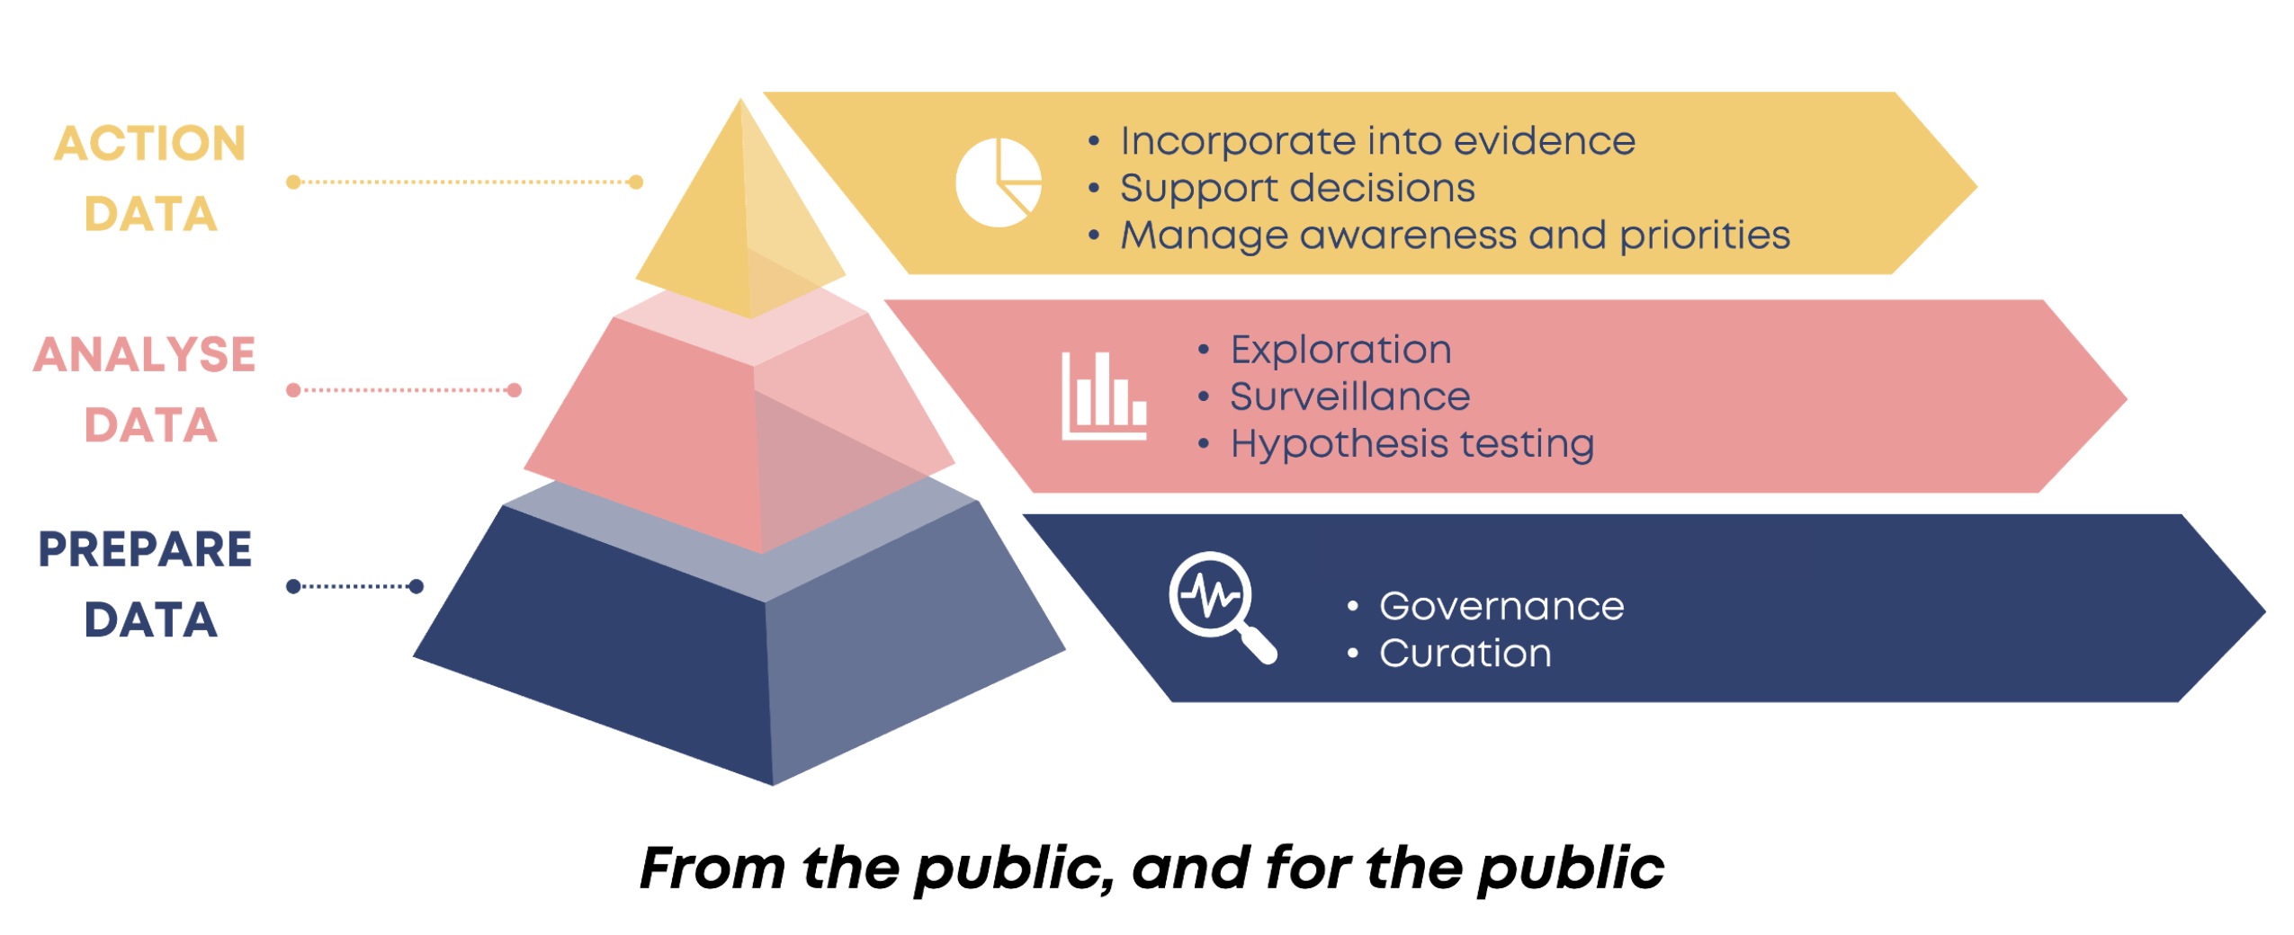
Charter: Civic Data Cooperative
Field-leading engagement and involvement of residents in determining uses of health & care data and shaping approaches to artificial intelligence (AI)
CHIL’s charter to mobilise data into action in new ways comes from our residents via the Civic Data Coop

Slide 15
Current Themes and Projects
MENTAL HEALTH (connected: digital, comorbidities, community/systems…)
M-RIC, Data Action Accelerator, CHI-Zone, 4M
INFECTION RESILIENCE (antimicrobial resistance, pandemic preparedness…) AMR-X, Data Action Accelerator, CAMO-Net, FluVue, Pandemic Institute, BRIT, CHI-Zone, HPRU GI
MEDICINES OPTIMISATION (safety, genomics, companion-AI, polypharmacy, multimorbidity…)
DynAIRx, OLS Data Action Accelerator, CHI-Zone, M-RIC , SysteMatic
HEALTH & CARE SYSTEMS (pressure-resilience, equity, life-course, population health…) PHIRST LiLaC, Data into Action, C-GULL, Round E’re, SysteMatic, M-RIC, HDRC, GroundsWell, ARC NW Coast
METHODS & INFRASTRUCTURE (training, methodology, digital infrastructure…) CDC , M-RIC, HOD2, ARISTOTELES, CIPHA/SDE, Data Action Accelerator

Slide 16
NHS Data Governance
Managed by NHS Cheshire & Merseyside Integrated Care Board via the Data into Action Programme Board/Team
NHS Senior Responsible Officer sits on CHIL Leadership Team
Operating model for data curation, analytics, and making intelligence actionable
Requirements identification | Feasibility assessment | Impact evaluation | Solution scoping | Information Governance Assurance | Data curation | Insight generation | Action
1 | 2 | 3 | 4 | 5 | 6 | 7 | 8
CVD
Cancer
Access to services
Onboarding
Technical Delivery
Business Change

Slide 17
Data into Action Delivery
Delivery partners | Requirements identification | Feasibility assessment | Impact evaluation | Solution scoping | Information Governance assurance | Data curation | Insight generation | Action
ICB Data into Action Team | X | X |  | X | X | X |  | X
CHIL | (X) | X | X | X |  |  | X
NHS Business Intelligence | X | X |  | X | X | X | X
Pop. Health Intelligence | X | X |  | X |  | X | X
Providers | X |  |  | X |  |  | X | X
Places | X |  |  | X |  |  |  | X
ICB Transformation |  |  |  | X |  |  |  | X
CVD
Cancer
Access to services
Agile prioritisation reflecting dynamic system needs:
Project will likely have significant impact across Cheshire & Merseyside in terms of care quality/value, population health or social/economic impact
Project is funded
Project is driven by a national directive
Project is can be delivered quickly without major support from ICB staff – ‘quick win’

Slide 18
CHIL Governance with NHS
University Leadership
(monthly)
NHS Integrated Care Board Leadership
(bimonthly)
Operations
(fortnightly)
Data into Action Operations
(monthly)
Stakeholder Board
(bimonthly)
Platforms Tech & Civic Data Coop (fortnightly)
Data & Technology (including CIPHA & NW SDE)
(monthly)
Data into Action Programme Board
(bimonthly)
Centre Leadership (weekly)
Research Data Action Research Team (DART: weekly)
Patient & Public Engage & Involve
(monthly)
Education & Training (fortnightly)
Population Health Mgt. Academy
(monthly in Ops meeting)
Innovation & Growth (fortnightly)
Research/Innovation Strategy Group
(bimonthly)

Slide 19
Rationale for adoption by IRIS:
Reasons for the adoption of CHIL by IRIS include:
It already exists and includes all relevant stakeholders
Is funded
Provides a Liverpool USP
Provides agility into the system and a mechanism for leveraging inward investment

Slide 20
Broad outline of mechanism / process:
The 3 possible areas where issues to be addressed innovatively would come from are:
ICB to define issues for which innovative solutions are needed
CHIL to identify innovations and or additional problems with solutions that may add value to IRIS / ICS
Star Chamber approach (brainstorming between suitably motivated and qualified individuals)

