Slide 1
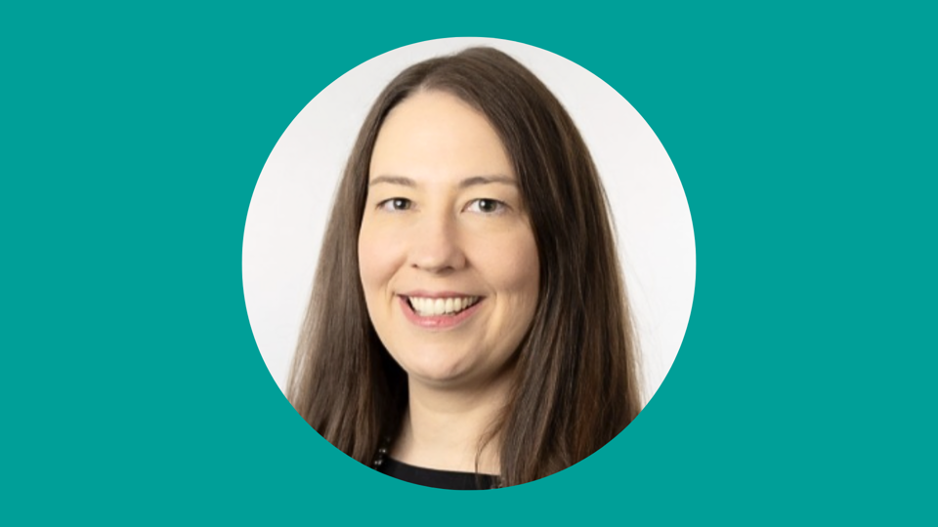
Translating IMPACT:: LUHFT’s Approach Siobhan Roberts Director of Quality Improvement Liverpool University Hospital Foundation Trust
Notes:
Breakout signs can be moved into place in readiness for after lunch
Fiona – to review any questions during this session from cards

Slide 2
Trust Strategy
Organisational Culture
and
Leadership Framework
Operating Model and Management System
Planning
Governance and Assurance
Daily Operations
Improvement and Innovation
Skill requirement segmented by job role to deliver strategy

Slide 3
Quality and Safety Strategy Session

Slide 4
Key Discussion 1: How are we defining Quality?
Institute of Medicine
Safety
Effectiveness
Patient Centred
Timeliness
Efficiency
Equity
Sustainability (RCP Addition)
Experience of Care
Per Capita Cost
Population Health
Staff Well-Being
Equity
Quintuple Aim
NHS Definition
Safe
Effective
Experience
Well-led
Sustainable
Equitable

Slide 5
Quality = Services that are reliably:
Person-centred: Where patients and staff are the definitive focus and define what quality care is.
For patients: Providing care that is respectful of and responsive to individual preferences, needs, and values and ensuring that patient values guide all clinical decisions.
For staff: Developing a workforce that is fit for purpose by creating a supportive and inclusive place to work, thrive and learn; and equipping our people with the capability and skills to do their jobs well.
Safe: Minimising harm to patients from the care that is intended to help them.
Effective: Providing services based on scientific knowledge to all who could benefit and refraining from providing services to those not likely to benefit (right time, right patient, right treatment).
Sustainable: Considering not only the needs of the patient today but the needs of the population in general and the patients of the future.
Timely: Avoiding waits and potentially harmful delays in the delivery of healthcare, incorporating the deployment of health interventions to anticipate and prevent illness.
Efficient: Making best use of limited resources. Avoiding wasting resources (including materials, time, ideas, energy), while increasing value.
Equitable: Striving for a level playing field where care does not vary in quality because of personal characteristics such as gender, ethnicity, geographic location, and socioeconomic status.
Person - Centred
Safety
Effectiveness
Timeliness
Efficiency
Equity
Sustainability

Slide 6
Key Discussion 2: Do we need a Quality Strategy?
NO
Consensus Recommendations
No separate Quality and safety strategy
IoM is the favourite definition of quality but shift ‘people’ into the centre
Delivery can’t just be a list of projects; Need to think in terms of skills, capabilities, and structures to achieve strategic aims
Not organised by individual portfolio

Slide 7
Trust Strategy
Organisational Culture
and
Leadership Framework

Slide 8
Leadership Enhancement Framework The Domains explained
This looks at my own self awareness and self management. It involves ensuring that I understand both what is my best self and what I need to do to bring that best self consistently to work
This challenges the view that we are too busy to stop and think. Real change comes from making time and space for real creativity and innovation
This considers how I regain proactive control of events around me rather than merely reacting to competing pressures and situations
Focuses on our role in creating an environment and culture that values, recognises and supports every member of our teams and services to thrive - across LUHFT and the wider system
This looks at our role in leading change and improvement across our teams and services. Supporting those around us identify opportunities to drive innovation, to navigate change successfully and develop an improvement mindset
Data powers the NHS, its key to understanding and improving all of our services. It drives innovation and research, helps us to reduce inefficiencies and health inequalities and improves patient outcomes

Slide 9
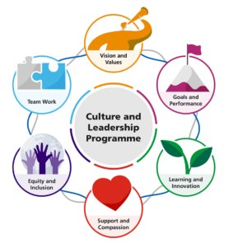
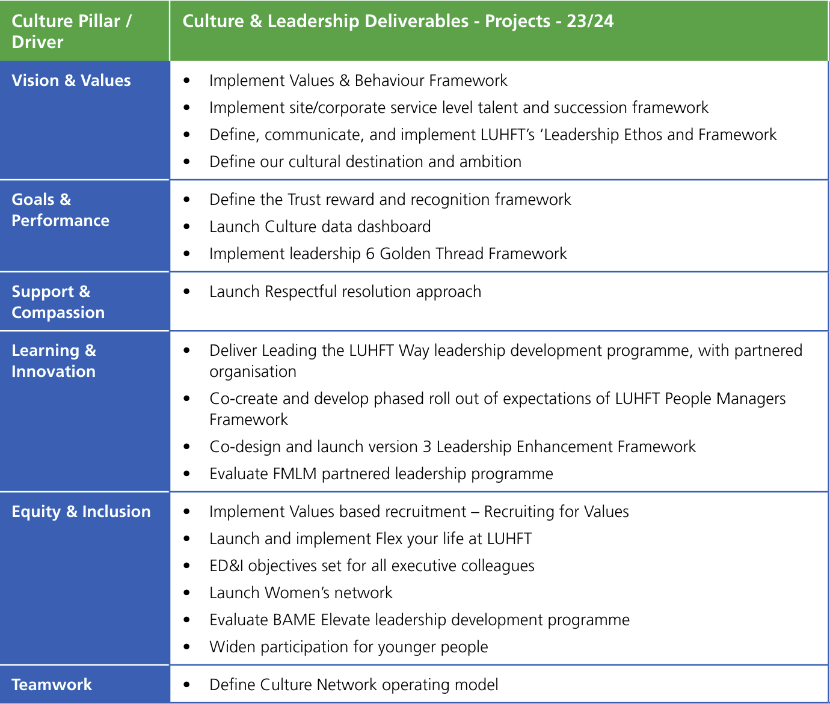
Culture Programme

Slide 10
Trust Strategy
Organisational Culture
and
Leadership Framework
Operating Model and Management System
Planning
Governance and Assurance
Daily Operations
Improvement

Slide 11
What is a Quality Management System?
Quality Control
Quality Improvement
Quality Planning
Rooted in management theory that draws from various sciences
Deliberate organisational design
Happens at multiple levels of the organisation
Management System
Planning
Structures, role clarity, processes, tools, and routines to:
Translate the Trust strategy into delivery plans with goals
Governance and Assurance
Structures, role clarity, processes, tools, and routines to:
Inform those situated outside the daily work of whether the work is meeting its planned goals.
Information is often reviewed at some retrospective interval by managers in a hierarchy.
Daily Operations
Structures, role clarity, processes, tools, and routines to:
Monitor reliability of performance daily by wards/departments/teams against goals by the people doing the work to inform daily adjustments.
Improvement and Innovation
Structures, role clarity, processes, tools, and routines to:
Solve problems, continuously improve, completely redesign or innovate on those things that cannot be resolved within daily operations, in the moment.

Slide 12
What’s in LUHFT’s Management System?
The Baseline Review
Management System
Planning
Governance and Assurance
Daily Operations
Improvement and Innovation
Wide variation in practice of:
Standardisation
Accountability
Visual management
Escalation
Problem solving
Integration
Planning has, in the past, focused on the nationally mandated aspects like finance, activity, and workforce
New risk framework, site and committee structure working
Wide variation in practice
Not seen to be as normalised as governance and assurance

Slide 13
What do we want in our Management System?
Management System
Planning
Governance and Assurance
Daily Operations
Improvement and Innovation
Reliability science
Measurement for assurance
Breadth and depth focus
Virginia Mason Production System
Ward operations
Standard work
1
Create a rich data stream
3
Make redesign decisions
4
Rapidly implement planned changes
5
Check reliability and effectiveness
2
Analyse and test insights

Slide 14
UCL Nightingale: Learning Framework
Notable Design Features:
Focus on both design of solutions and reliability of implementation
Integrate quantitative and qualitative data from multiple sources
Incorporates QI, Project Management, and Design tools
Fix, Improve, Change
1
Create a rich data stream
Data: SOPs for key proceses ex. SIs, complaints, etc.)
2
Analyse and test insights
Rapid data analysis and insight
3
Make redesign decisions
Improved action planning: 'Fix, Change, Improve'
4
Rapidly implement planned changes
PDSA Cycles
5
Check reliability and effectiveness
Communicate learning and test effectiveness

Slide 15
Trust Strategy
Organisational Culture
and
Leadership Framework
Operating Model and Management System
Planning
Governance and Assurance
Daily Operations
Improvement
Skill requirement segmented by job role to deliver strategy
Skill requirement segmented by job role to deliver strategy

Slide 16
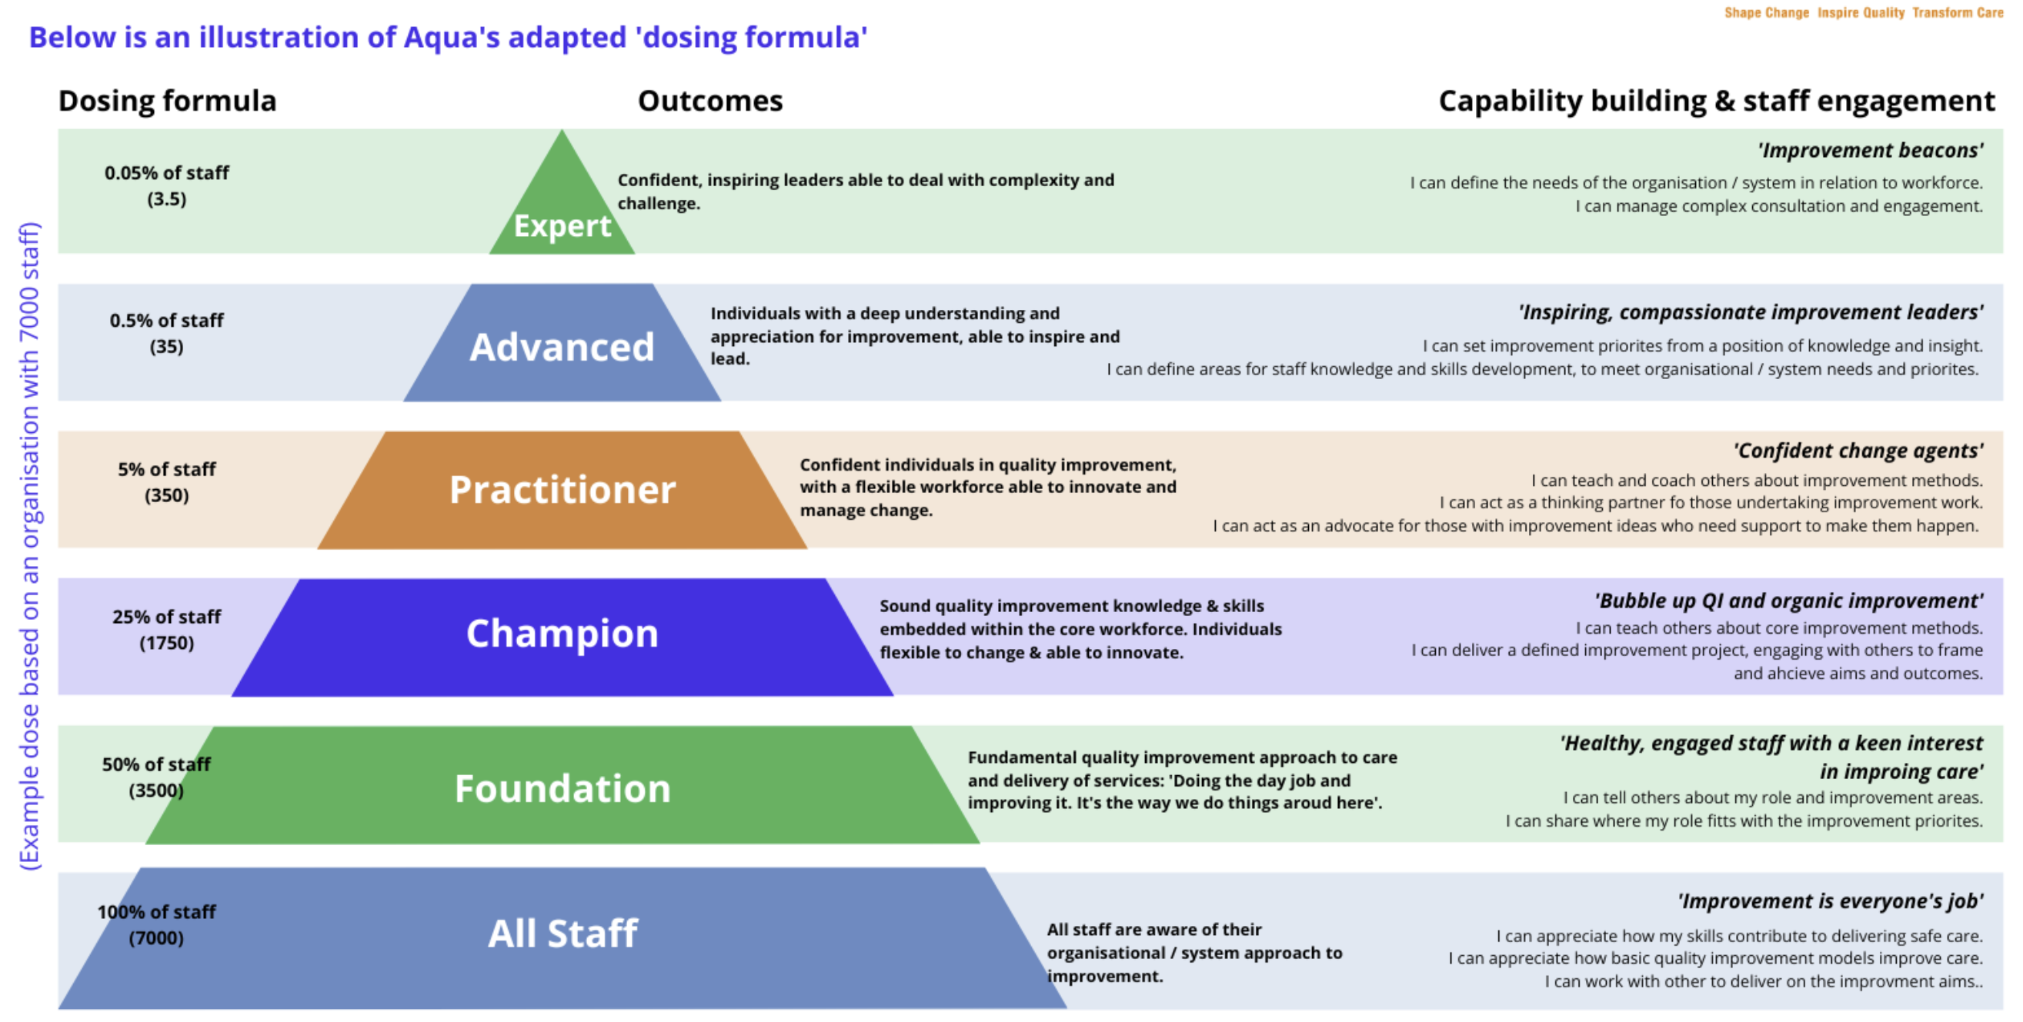
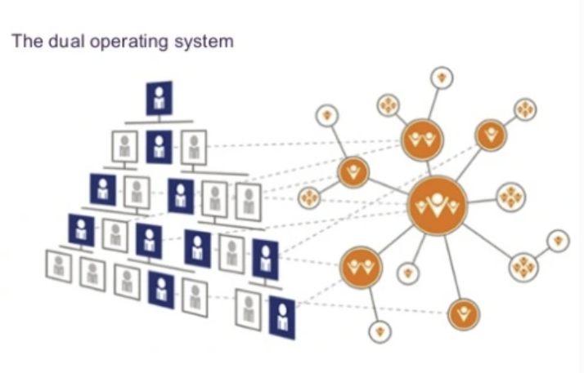
Capability Building
5 Year Delivery Plans

Slide 17
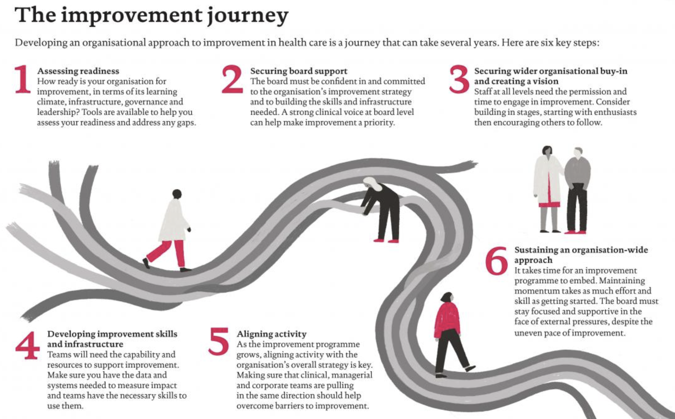
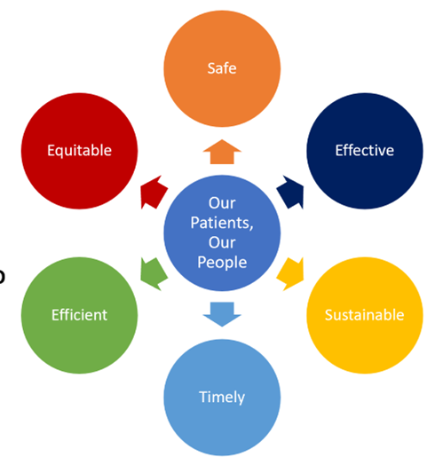
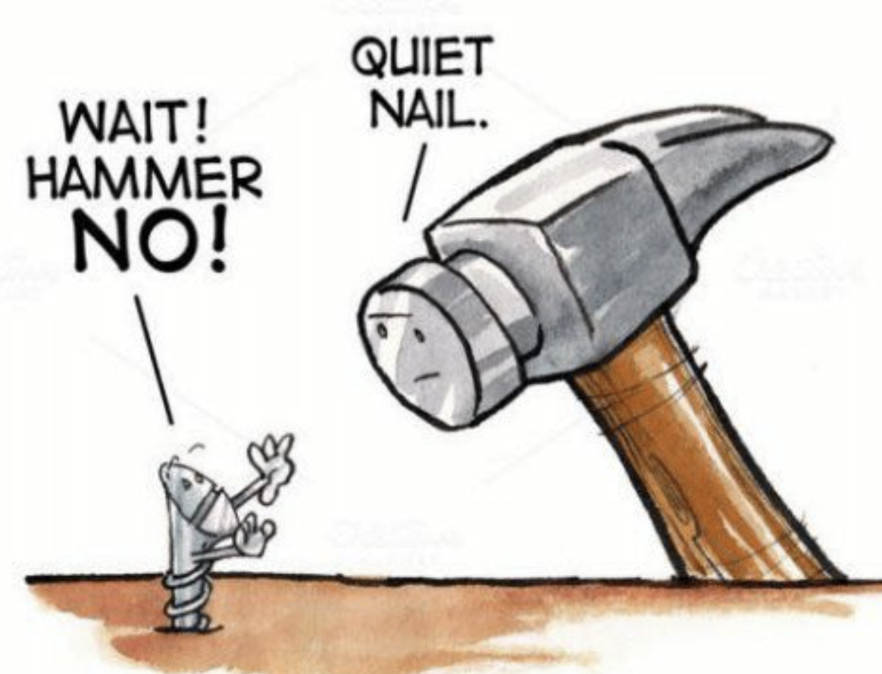
IMPACT Take-aways
Helped us envision our own roadmap
Think ‘mainstream’
Use tools but grow your roots in theory
5 Year Delivery Plan(s)

