Slide 1
An Introduction to System Leadership
Cath Sloan, Head of System Transformation

Slide 2
What’s all the fuss about systems anyway?
Integrated Care Systems
‘Joining up care leads to better outcomes for people. When local partners – the NHS, councils, voluntary sector and others – work together, they can create better services based on local need’
‘Partnership is the golden thread that runs through all levels of integrated care systems (ICSs) – from neighbourhood and place, through to system and region – creating opportunities for partners to join up and work together to improve outcomes for local populations’
Source: NHS England

Slide 3
Notes:
3

Slide 4
What is a system?
‘A system is a group of interacting or interrelated elements that act according to a set of rules to form a unified whole.’
‘A system, surrounded and influenced by its environment, is described by its boundaries, structure and purpose and is expressed in its functioning’
Source: Wikipedia

Slide 5
Simple, complicated or complex?

Slide 6
Notes:
https://www.youtube.com/watch?v=V38HrPnYkHI

Slide 7
Flocking Exercise
3 simple rules:
COHESION
All individuals are aware of their nearest neighbours
ALIGNMENT
Individuals have a tendency to ‘line up’
SEPARATION
Individuals stay close together but maintain a small distance
Simple rules can lead to surprisingly coherent system level results
Notes:
We have spent a lot of time building Trust as a group and how this helps build stronger relationships. This model brings to life lots about what we know of high performing teams and the ingredients that makes a successful group.

Slide 8
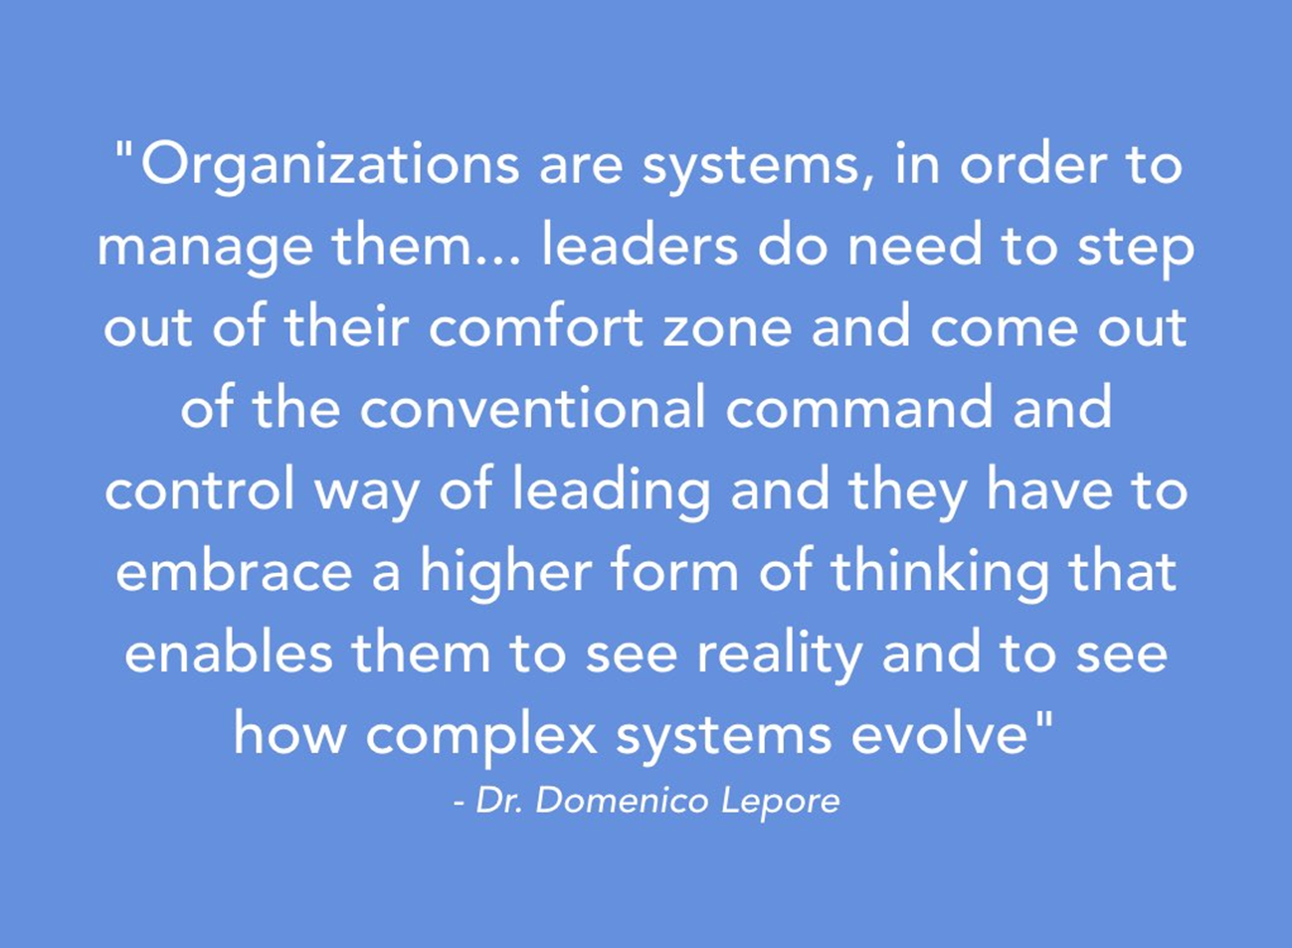

Slide 9
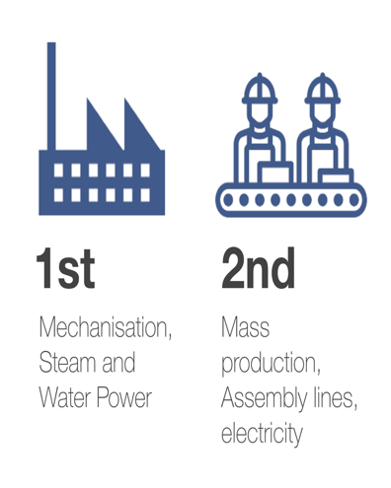
The traditional approach to leadership
Mechanistic Paradigm: If you understand the parts, you’ll understand the whole
Reductionist
Linear; cause and effect
Disconnected
Analytical
Hierarchical
Command and control
Defined roles and responsibilities
Centralised
Notes:
Step up a gear
run like clockwork
run like a well oiled machine
the machinery of government
policy instruments
policy levers

Slide 10
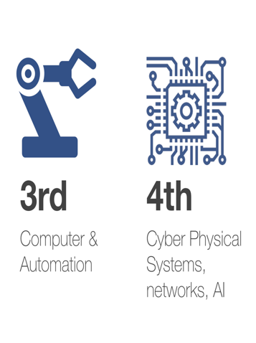
The traditional approach to leadership
System Paradigm: The whole is greater than the sum of its parts
Holistic
Non-linear, multiple factors affect outcomes
Connected
Synthesis
Distributed
Interdependant
Relational focus
Emergent
Notes:
Step up a gear
run like clockwork
run like a well oiled machine
the machinery of government
policy instruments
policy levers

Slide 11
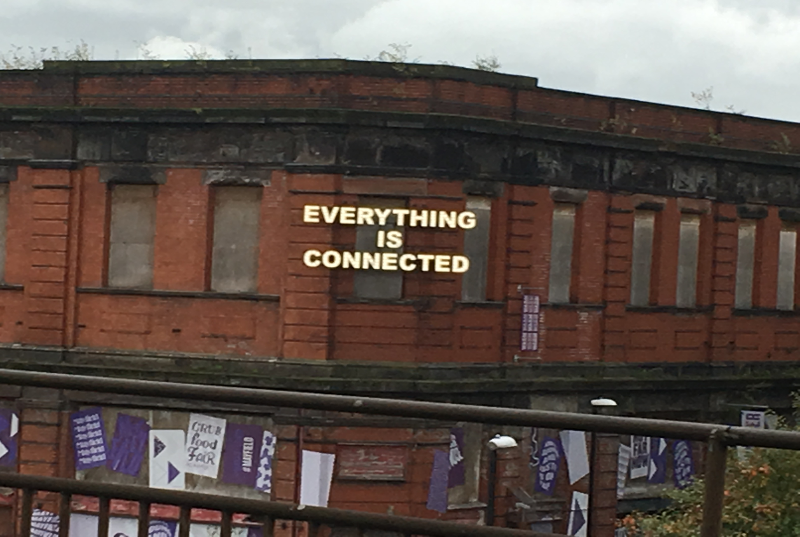

Slide 12
Discussion
What kind of leadership behaviours do you see in your local system?
What opportunities and challenges do these bring?

Slide 13
7 Dilemmas of System Leadership
2
Short Term ££ constraints
1
Long term cost savings
1
Big ambition, scale & spread
2
Small steps, locally developed, place based
2
Clarity of goals &purpose
3
3
Uncertain, messy & emergent
Survival now
4
Sustainability for the future
4
Emphasis on control, order& consistency
Emphasis on experiment, autonomy & innovation
5
5
Working at pace
6
6
Take time to involve & include
Based on a single vision
7
Allows multiple visions
7
Source: Weir & Hardacre 2018

Slide 14
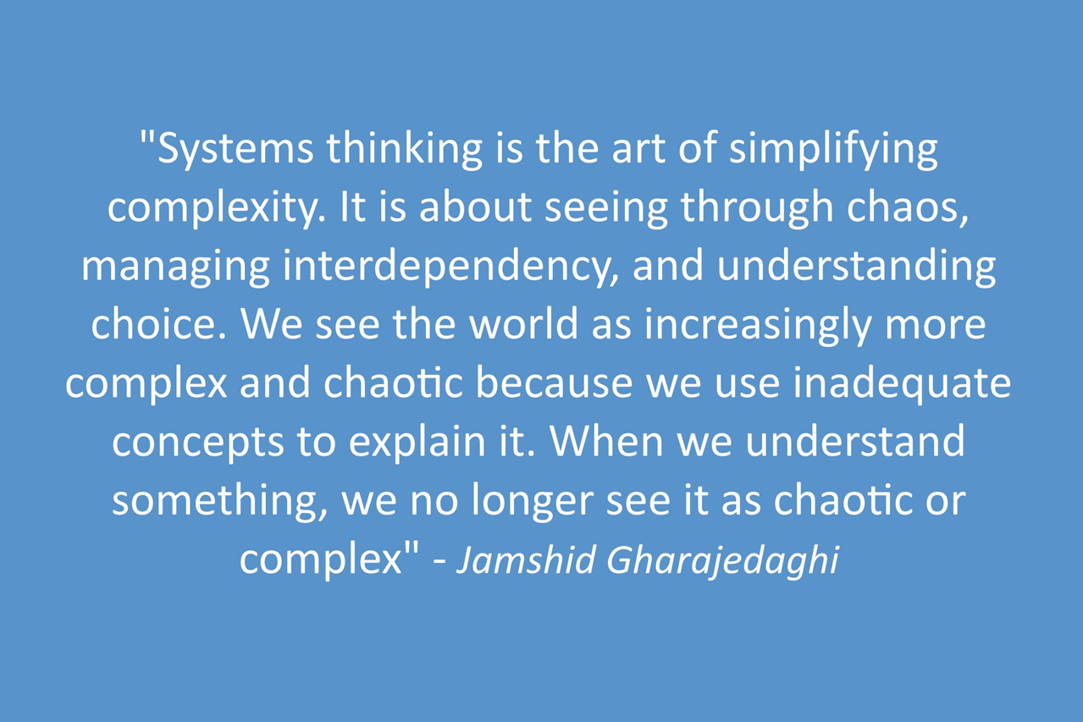
Notes:
14

Slide 15
Effective system leadership behaviours
Tasks & Ideas
Relationships & Behaviours
Be Courageous
Distribute leadership and decisions
Embrace
uncertainty
Adopt an open and enquiring mind set
Draw on widely diverse perspectives
Go out of your way to make connections
Be Curious
Establish a compelling vision
Invest in promoting values
Be Clear
Create safe spaces to frequently connect
Actively listen and communicate mindfully
Care deeply for self and others, recognising our individuality
Be Compassionate
Source: Welbourn & Fathers (2012)
Adapted by Aqua (2020)
Notes:
Effective leadership behaviours
Diagram showing:
Range from Task & ideas to Relationships & behaviours
Be courageous – Embrace uncertainty; Distribute leadership & decisions
Be curious – Adopt open enquiring mindset; Draw on widely diverse perspectives; Go out of your way to make connections
Be clear – Establish compelling vision; Invest in promoting values

Slide 16
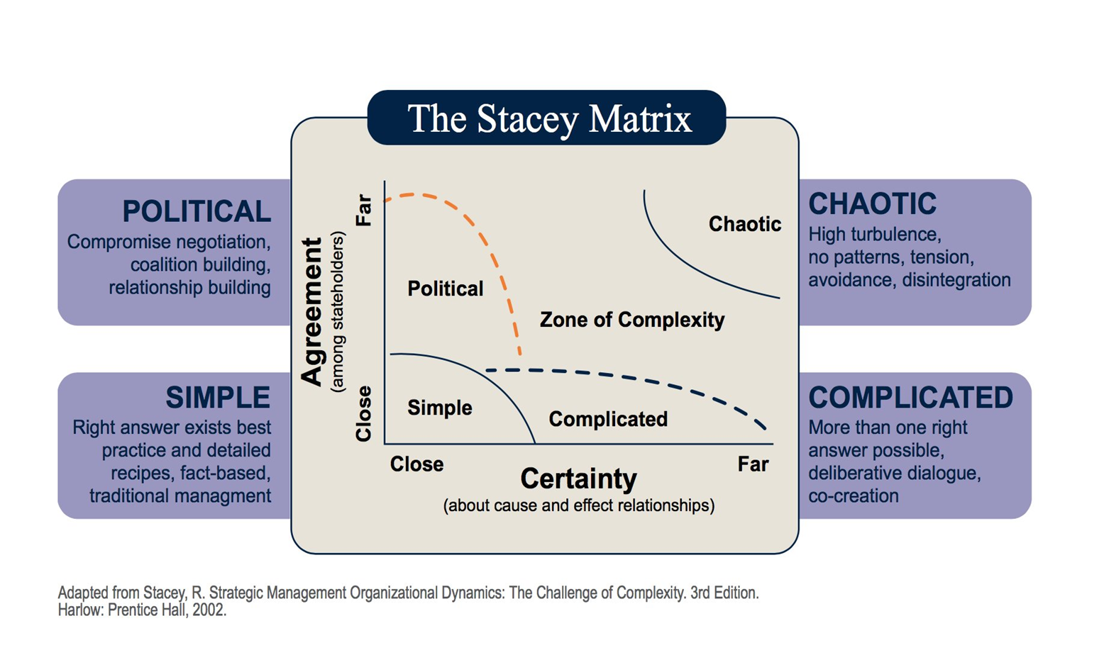
Notes:
AQUA
Our – 8b leadership community
Shared – what unites you as together as a leadership community?
Purpose – What is your higher purpose, what matters to you all?
3 groups in total (no more than 6 in a group) 15 mins having a go, 10 mins to share.
16

Slide 17
Personal Reflection
What do you think your personal strengths are as a system leader ?
What skills, knowledge and behaviours do you need to develop further?

Slide 18
Observe and understand the broader system
Master the art of intervening in the system
Orchestrate collaboration in the system
Foresee and manage system-wide risks
Lead with a new mindset
Notes:
https://www.youtube.com/watch?v=V38HrPnYkHI

Slide 19
Personal Reflection and Action
What are the changes you need to make in your approach and behaviours as a leader in a complex system?
What one action will you take as a result of what you have heard today?

Slide 20
Evaluation

Slide 21
Thank You

