Slide 1
Alder Hey Improvement Journey
April 2024
Notes:
Nathan

Slide 2
Journey to outstanding slide
Notes:
Nathan

Slide 3
“Making it normal to improve”
Brilliant Basics Improvement System
Leading
Improvement
Delivering
Learning
Notes:
Nat
There are three elements to our improvement system, each with a key focus that contributes to the whole.
Leading
Developing a style of leadership, at all levels of the organisation, that enables a consistent and systematically applied way to support problem solving and improvement to thrive.
Leader standard work. The Executive team developed and implemented their own set of standards to enable a more specific focus on priority areas, a better grasp on daily safety of the organisation, improved meeting effectiveness and a focus on the voice of children, young people and families.
Developing our leaders to be ‘leaders of improvement’ is now built into our professional development offer and supported by bringing together leaders for tailored coaching, all focussed on continuous improvement.
Delivering
Brilliant Basics is the architecture for all sizes of change; small every day local changes right through to organisational priorities and strategic objectives.
We have built a shared vision through our updated strategy; Vision 2030. A single integrated plan for the organisation is aiding focus on what matters most.
Data driven decision making and assurance is central to our new way of working to ensure we are on the right track to meet the needs of our CYP&F and organisational priorities.
By using the focussed Brilliant Basics approach we have been able to achieve a 20% reduction in the number of administration and/or prescribing errors across Alder Hey as well as a 20% reduction of incidents causing harm.
A multidisciplinary team of services support Brilliant Basics. They include Improvement, Human Resources and Organisational Development, Freedom to Speak up, and Staff Wellbeing. These services wrap around teams to support them to make change happen and to make it stick.
Our principles for delivery are focussed on listening to the voice of children, young people and their families and our staff to identify problems and codesigning change that is tested and measured for impact. Our children, young people and their families said “it’s just about making it normal to improve”.
Learning
All staff are provided with an understanding of Brilliant Basics as soon as they join the organisation, so everyone is clear that this is the way we work.
We have a suite of resources supported by a knowledge matrix, so all our staff know what they need to know and do for improvement as part of their role in the Brilliant Basics system.
This is all delivered in a bespoke, flexible approach utilising our online resources, designed specifically to fit in the everyday working life .
This, in conjunction with improvement coaching, helps to embed new tools, routines and behaviours. “It’s great to see when teams make small and simple changes that have a massive impact on their everyday work.”
We also have a group of ‘improvement connectors’; frontline colleagues from various staff groups across the organisation with enhanced improvement knowledge and skills. They bridge between their frontline team and the central Brilliant Basics team growing and spreading improvement capability and capacity directly to the frontline.

Slide 4
Mainstreaming improvement
People
Finance
Experience
Ops
Safety
Strategy
Notes:
Nat
There are three elements to our improvement system, each with a key focus that contributes to the whole.
Leading
Developing a style of leadership, at all levels of the organisation, that enables a consistent and systematically applied way to support problem solving and improvement to thrive.
Leader standard work. The Executive team developed and implemented their own set of standards to enable a more specific focus on priority areas, a better grasp on daily safety of the organisation, improved meeting effectiveness and a focus on the voice of children, young people and families.
Developing our leaders to be ‘leaders of improvement’ is now built into our professional development offer and supported by bringing together leaders for tailored coaching, all focussed on continuous improvement.
Delivering
Brilliant Basics is the architecture for all sizes of change; small every day local changes right through to organisational priorities and strategic objectives.
We have built a shared vision through our updated strategy; Vision 2030. A single integrated plan for the organisation is aiding focus on what matters most.
Data driven decision making and assurance is central to our new way of working to ensure we are on the right track to meet the needs of our CYP&F and organisational priorities.
By using the focussed Brilliant Basics approach we have been able to achieve a 20% reduction in the number of administration and/or prescribing errors across Alder Hey as well as a 20% reduction of incidents causing harm.
A multidisciplinary team of services support Brilliant Basics. They include Improvement, Human Resources and Organisational Development, Freedom to Speak up, and Staff Wellbeing. These services wrap around teams to support them to make change happen and to make it stick.
Our principles for delivery are focussed on listening to the voice of children, young people and their families and our staff to identify problems and codesigning change that is tested and measured for impact. Our children, young people and their families said “it’s just about making it normal to improve”.
Learning
All staff are provided with an understanding of Brilliant Basics as soon as they join the organisation, so everyone is clear that this is the way we work.
We have a suite of resources supported by a knowledge matrix, so all our staff know what they need to know and do for improvement as part of their role in the Brilliant Basics system.
This is all delivered in a bespoke, flexible approach utilising our online resources, designed specifically to fit in the everyday working life .
This, in conjunction with improvement coaching, helps to embed new tools, routines and behaviours. “It’s great to see when teams make small and simple changes that have a massive impact on their everyday work.”
We also have a group of ‘improvement connectors’; frontline colleagues from various staff groups across the organisation with enhanced improvement knowledge and skills. They bridge between their frontline team and the central Brilliant Basics team growing and spreading improvement capability and capacity directly to the frontline.

Slide 5
Brilliant Basics Principles
The
Approach
Notes:
Nat
The way we work through Brilliant Basics is underpinned by these 8 principles: We apply these principles to everything that we do in Alder Hey.
Listen – this is listening to CYP and their families, listening to your colleagues and making sure that what matters to them is heard and acted upon
Focus – Make sure that we are focusing on what matters the most to us as staff, to our CYP and their families to make sure we focus on the issues that causes most problems to maximise impact.
Be informed – By colleagues who understand the issues and how the work is currently done; work with and learn from others “Shared Best Practice”
Empower – Make sure that you, your colleagues are empowered to make change; improvement belongs to everyone.
Challenge – Enabling you to challenge assumptions and thinking, but always make sure that we challenge in a respectable way not to be rude.
Data Driven – Use your data to inform change and demonstrate measurable improvement. Without data how can you know if a change has actually happened?
Adapt – A single, easy to-follow method with problem solving tools that help us to do this. Open our minds to new ways of thinking.
Vision – Let our vision drive everything that we do. A healthier, happier, and fairer future for children and young people.

Slide 6
PATIENT SAFETY STRATEGY PROGRAMME: Summary Overview Update
Author: Will Weston & Lucy Whitfield Date: January 2024 Workstream: Programme Overview
Patient Safety is the guiding principle of all who serve in the NHS. Our vision is for Alder Hey to ‘continuously improve patient safety’. This involves building on the foundations of a patient safety culture and systems with three aims, revolving around insight, involvement and improvement. This Programme Summary Overview Update slide follows the Programme meeting held on 14/12/2023 and is supplemented by an Assurance Report slide and Summary Overview Update slides from individual workstreams.
# | Deliverable / Workstream | Priority | Owner | BRAG
1 | Suite of safety Metrics | 1 | W Weston | G
2 | Implement New Digital System | 3 | P White | G
6 | Negligence and Litigation | 3 | C Talbot | G
7 | CYP & Families as PS Partners | 3 | P Brown | G
8 | Education & Training on PS | 1 | C Talbot | G
10 | Implement PSIRF, Safety I & II | 2 | J Rooney | G
13 | Neonatal Newborn Screening | 2 | R Hanger | G
15 | Parity of Esteem | 2 | J Pointon | A
16 | Learning Disabilities | 2 | J Kiernan | G
17 | Antimicrobial Resistance (AMR) | 2 | B Larru + A Taylor | G
21 | Hospital Optimisation | 1 | R Hanger/ J Guy A Hanson, R Viner | A
22 | Unacknowledged Notices | 2 | M Neame | G
Success Highlights | Scrutiny of blue workstreams: 1, 13, 16, 17 and 21. WS1: Suite of safety metrics (Reporting)- Downward trend in relation to number of incidents rated minor harm & above. Upward trend in relation to number of incidents rated no harm & near miss (not statistically significant). Positive or continuation of trends In 3 areas [Sepsis; Deteriorating Patient; Safety Training- see circled IPR slide]. WS13: Neonatal Newborn Screening- Received first metrics report from NHS England – not meeting national targets as expected- next steps are to provide assurance and redefine more purposeful metrics in relation to screening. Joint Newborn Screening Oversight Meetings to be held with Liverpool Women’s Hospital moving forward. WS16: Learning Disabilities- Continuing to meet target in relation to percentage of appropriate referrals – target 90%. Discussions around implementing a parent and carer forum. Oliver McGowan E-Learning training rolled out in October – good uptake so far: 25% to date. WS17: Antimicrobial Resistance (AMR)- Currently Meeting 2023/24 CQUIN (Prompt switching of intravenous to oral antibiotics). Not achieving national antimicrobial prescribing targets as set out in NHS Standard Contract – submitted funding request for ICNET as extra data required to help tackle this. Currently exploring funding options to obtain Global Antimicrobial Stewardship Accreditation. WS21: Hospital Optimisation- Acutely Unwell Child: Successful deployment of rapid pathway, and governance structure now embedded within Response Team. 75% of patients with escalation plan in place, however, requires further ownership out of hours period. Escalation of deteriorating patients remains problematic.
Challenges & Difficult Decisions | Assurance Update: Progress needed re timely update of actions. Requirement for meaningful programme specific data and metrics. Prioritisation of workstreams necessary due to limited PM and BI support.
Milestones / Next Meeting | Next meeting scheduled for 25/01/2024.
Key Messages | Implementation of PSIRF (Go Live date 01/01/2024). Weekly Patient Safety Incident Response Investigation (PSIRI) Panel Meetings to commence from 11/01/2024.
INSIGHT: Improving understanding of safety by drawing intelligence from multiple sources of patient safety information
INVOLVEMENT: Equipping patients, staff and partners with the skills and opportunities to improve patient safety throughout the whole system
IMPROVEMENT: Designing and supporting programmes that deliver effective and sustainable change in most important areas
Notes:
Nathan
Patient safety board is set up is to use all principles from our Brilliant Basics approach.
Insight from our children, young people and families, staff closest to the problems and processes and data allows us to ensure that we have the right insight to inform our direction.
Involvement: working with the right people to fully understand problems, design and implement tests of change together make sure that sustainable improvements and ways of working are implemented.
Improvement: using our Brilliant Basics tools routines and mindset - the way that we work in Alder Hey.

Slide 7
Safe P2
Insight
Notes:
We use our data to drive assurance and decision making – being able to identify where there is a statistically significant change in the data over time is key to being able to celebrate improvement but also to be able to target focus of understanding and improvement efforts as required. An example of this is if we were still using RAG rating we might have a situation where something is rated green but the trajectory is worsening. Using data over time allows us to use the trend to make much more informed decisions.
For example the graph on the middle right shows us that have a reducing number of patients deteriorating is reducing we asked the analyst team to recalculate the control limits and have since noted that the changes has been a statistically significant improvement.

Slide 8
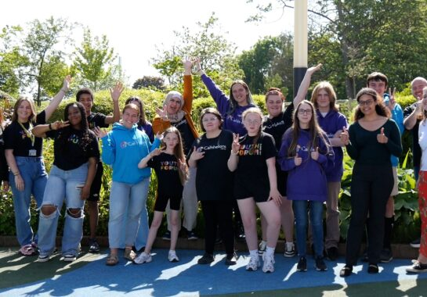
Involvement
Notes:
We are also working together with our Youth Forum to support the implementation of the framework for involving patients in patient safety.
Examples of this are the involvement of CYP in the weekly quality round that focussed on patient safety, sharing learning and raising awareness with families.

Slide 9
Improvement
A3 Problem solving thinking:
Problem Statement
Understanding the current state (data, processes, experience etc)
Vision and Goals
Deeper analysis
Change ideas and measures
Risks
PDSA cycles
Learning and celebrations
Notes:
Our method of improvement is based in Lean methodology.
A3 thinking is a structured approach to working through a problem, to gain deeper insight from the people closest to the problem, to understand the work as done. Then we can reliably design and implement tests of change with the same people who are closest to the work.
We adopt A3 thinking for all sizes of problems within the organisation whether that be big or small. This is built into patient safety board through all of the areas that are identified for improvement.

Slide 10
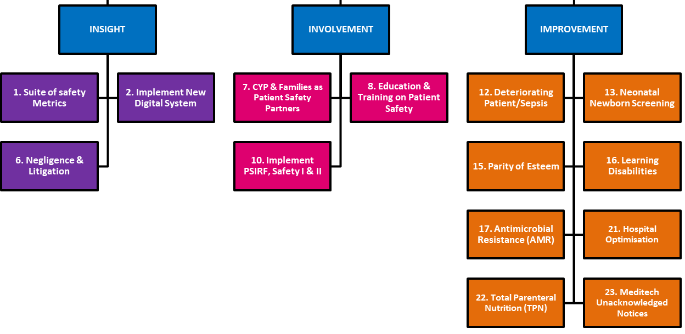
PATIENT SAFETY STRATEGY PROGRAMME: Summary Overview Update
Author: Will Weston & Lucy Whitfield Date: January 2024 Workstream: Programme Overview
Opportunity Statement | Patient Safety is the guiding principle of all who serve in the NHS. Our vision is for Alder Hey to ‘continuously improve patient safety’. This involves building on the foundations of a patient safety culture and systems with three aims, revolving around insight, involvement and improvement.
 |  | 14 Delivery Workstreams feed into the 3 overarching Aims, each with specified leads, timelines and objectives.
Escalation | None Required
Goal for the Improvement
Programme Overview
Effective Project Team: The Patient Safety Board meets monthly, there is a clear governance structure and good attendance from key stakeholders. There is evidence of meetings up to 14/12, with clear reporting, decision making, and use of data, challenge and lessons learned.
Scope and Approach: The Patient Safety programme comprises of 14 workstreams each at different stages in their delivery, a comprehensive PID is in place to describe project scope and approach.
Stakeholders Engagement: There is good evidence stakeholder engagement throughout December to advertise the implementation of PSIRF which went live 01/01/24. A PMS Weekly bulletin's describing the key messages, theme of the week and staff feedback. Safety Quality Assurance Committee Chair highlight reports are provided monthly. A monthly PSIRF Implementation Group is also in place with representation from all divisions.
Risks: There is 1 main project risk on InPhase (2721) with a score of 9, within review date.
EA QIA's: 9 of the relevant workstreams have now completed an EA QIA, 3 are not applicable, all required forms now in place.
Targets/benefits: A benefits tracker is available, metrics being tracked has increased to 22, there are 8 benefits tracked monthly and a number tracked annually. There has been progress made in month but there remains some metrics that are not being tracked without baselines. To achieve a final green rating the project should establish baselines and targets for the remaining benefits and indicate the frequency of tracking. Note: Risk reporting has reduced to 8 per month against a baseline of 17 (22/23), the target was to increase reporting. Total of 18 risks reported in last 4 months.
Milestones: A high-level milestone plan is in place for individual workstreams and milestones, clear evidence of momentum and progress. 2.12 Implement Reporting has been pushed back one week to w/c 12/4/23. Implementation of PSP and recruitment has been revised to January 24 - revised milestones are clear. Project should update and reprofile missed milestones.
Assurance Rating
Notes:
We have a programme level progress summary report alongside a chairs report that goes to SQAC.
This is project assurance – that we are running the work in an effective way.

Slide 11
PATIENT SAFETY STRATEGY PROGRAMME: Medication Safety Update
Author: G McIntosh/A Gill Date: Jan 2024 Workstream: Patient Safety 1 of 3
Problem Statement | Medication incidents are consistently the top cause of patient safety incidents reported across the Trust. A Brilliant Basics approach has been adopted by the team and priority projects were identified in 2022/23 with oversight of the Patient Safety Board. Goals have been reviewed in response to successes and learning from 2022/23.
Vision & Goals | Vision: To reduce, to zero, the medication errors arising from prescribing and/or administration that cause harm to patients by Quarter 4 of 2023/24.​ Goals: ​ (by March 2024) Reduce the number of medication incidents resulting in harm to patients by 25% Reduce the number of medication errors resulting in moderate harm to zero Reduce number of administration and prescribing incidents reaching a patient by 25% Reduce the number of 10-fold medication errors by 25% Increase the percentage of near miss reporting, as a marker for overall medication error reporting rates and the culture of reporting in the Trust PSIRF priorities: Introduce strategies to reduce the likelihood of delayed and omitted doses Improve the safety of administration of total parenteral nutrition
Strategic Objective | Safety, People, Prevention
Driver Metric | Number of medication incident reports submitted via InPhase
Next Steps | Due Date | Status
Deep dive into incidents causing harm in Q3 | Oct 23
TPN and delayed/omitted doses to feed into PSIRF group | Oct 23
Investigate differences in near-miss reporting between Divisions | Oct 23
Delayed and omitted dose dashboard to be validated and then launched at next Medication Safety Collaborative | Apr 24
PSIRF delayed and omitted medicines project to start on 3B as an outlier for late administration of medicines | Apr 24
Medication safety learning collaborative planning | Apr 24
Updated medication incident response guidance for managers to align to PSIRF principles | Apr 24
Status of Milestones | Due Date | Status
Band 8A medication safety pharmacist in post | Feb 24
InPhase data analysis/report extraction capabilities within team | June 23
Reformatted single version of Injectable Therapy Guidelines live | Jan 24
Guardrails project - standardisation of infusion concentrations implemented | Mar 24
Revised list of medications for single checking in Expanse | Mar 24
PSIRF project for TPN and Delayed/Omitted medicines completed | Jul 24
Actions Completed & Successes | Establishment of Band 8A medication safety pharmacist post (temporary) Increased proportion of near miss reporting in Q3 2023/24 across the Trust. Medication safety team have completed report builder training to support data analysis and development of dashboards for target areas Good engagement and attendance at Medication Safety Collaborative event.
Feedback & Lessons Learnt | By division, near miss reporting is approximately 50% of total reports in Medicine and 45% of total reports in Surgery Publishing of a delayed and omitted dose Power BI dashboard was awaiting re-establishment of links to Expanse.
Issues & Risks to escalate | End of secondment for temporary staff will impede progress with this work
Meeting attendees should have received your slide a week before the meeting. Please assume your slide has been read in advance, and so when presenting, focus on: 1. What message am I trying to convey i.e. How can I succinctly summarise the 3 vivid blue themes [90 seconds each]? 2. What response am I trying to elicit?
Notes:
This is an example of a project summary report on one of the previous improvement priorities. Behind this is detailed A3 document. The team and other key stakeholders have wrapped around this to develop their problem solving using the structured thinking process that all members of the trust are using as our consistent approach to improvement.

Slide 12
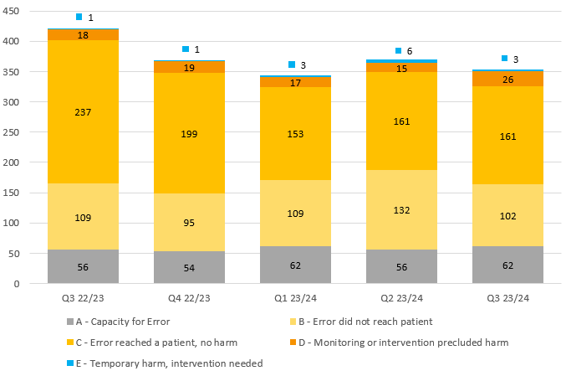
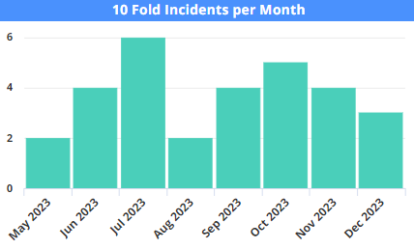
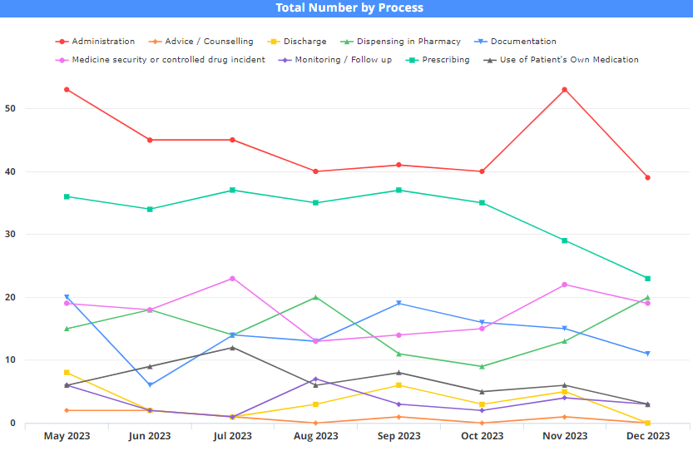
PATIENT SAFETY STRATEGY PROGRAMME: Medication Safety Update
Author: G McIntosh/A Gill Date: Jan 2024 Workstream: Patient Safety p2 of 3
Metrics and Analysis: Trend and Current Data vs Target
Total number of incidents by harm level:
Total number of incidents per department, coloured to show proportion of near miss reports:
(Green = near miss incident / Red = incident reached a patient)
10 fold medication incidents per month:
Proportions of process types per month:
Goals for 2023/24: | 22/23 total | 23/24 goal | 23/24 to date
To reduce the number of medication incidents resulting in harm to patients by 25% using 2022/23 a baseline | 47 | 38 | 44 (15 MERP E+)
To increase the percentage of near miss reports (MERP A & B) using 2022/23 as a baseline | 43% | 45% | 48%
To reduce the number of medication errors resulting in moderate harm (MERP F+) to zero | 1 | 0 | 0
To reduce the number of administration and prescribing incidents reaching a patient (MERP C+) by 25% | 608 | 453 | 385
To reduce the number of 10-fold medication errors by 25% using 2022/23 as a baseline | 46 | 35 | 32 (9 reached a patient)

Slide 13
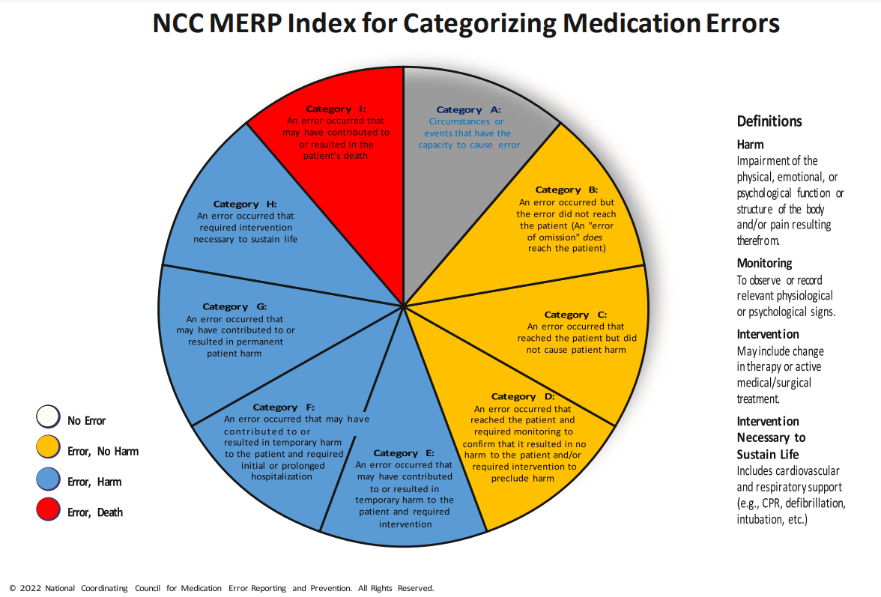
Medication Incidents Resulting in Harm: Quarter 3 (Oct-Dec) 2023 |  |  |  | https://www.nccmerp.org/sites/default/files/index-color-2021-draft-change-10-2022.pdf
LFPSE | 16x LOW physical harm (5% of total reported) | No ten-fold errors. Skin reactions from topical anaesthetics have been noted thrice this quarter and also in previous quarters due to prolonged use or missed allergy status. The medication safety team are working on potential solutions to improve documentation of these on Expanse. Communication of treatment plans between prescribing and nursing teams continues to be a key contributing factor to harmful incidents.
NCC MERP | 5x MERP E – error, temporary harm 11x MERP D – error, no harm, monitoring required
PROCESS (multiple can be selected per incident) | 5x prescribing 10x administration 2x monitoring and follow up 2x discharge 1x use of patient own medication
TYPE |  | SURGERY DETAILS | Patient did not receive salbutamol nebulisers frequently enough due to miscommunication between teams, resulting in deterioration and escalation of treatment. (E) Patient not provided with antibiotics post theatre from day case. Patient had been grafted, returned to the ward for review of wound and the wound was found to be infected and the graft lost. (E) Ametop applied to patient with known allergy. Irritated skin. (E) Patient given antihypertensive medication intended for a different patient. (D) Hourly salbutamol nebulisers not given overnight. Required increased frequency when realised. (D) Gentamicin sample not taken at the right time resulting in extra being taken from patient. (D)
 |  | MEDICINE DETAILS | Mild frostbite injury from prolonged use of ethyl chloride spray. (E) Undocumented application of ametop resulting in prolonged use. Irritated skin with blister and peeling skin. (E) Patient given a double dose of phenytoin for her weight in ED. Required a phenytoin level which was high. (D) Patient prescribed an antibiotic that had a known interaction with their chemotherapy. Patient was slow to clear the chemotherapy leading to the use of glucarpidase treatment. No other observed harm. (D) Delay to treatment of measured low blood glucose levels due to unavailability of stock on the ward. Prolonged period of drowsiness. Stable following treatment. (D) Patient a medication that contains 38% alcohol and is therefore not suitable for children, despite being licensed for children. Product not identified as being unsuitable for 14 months. (D) Patient discharged without having their portacath flushed – needed to return to the ward for this. (D) Fluids administered too fast overnight, several extra bloods test required. (D) Patient received an extra dose of medication due to being booked into day case at 2-week intervals rather than 4-week. (D)
DIVISION
DEPARTMENT
DEPARTMENT |  | COMMUNITY DETAILS | Psychotropic medication was prescribed and administered without Consultant oversight. Consultant was informed after the event. Rapid tranquilization policy followed and no clinical indication for the diazepam to be administered at that moment in time. (D)

Slide 14
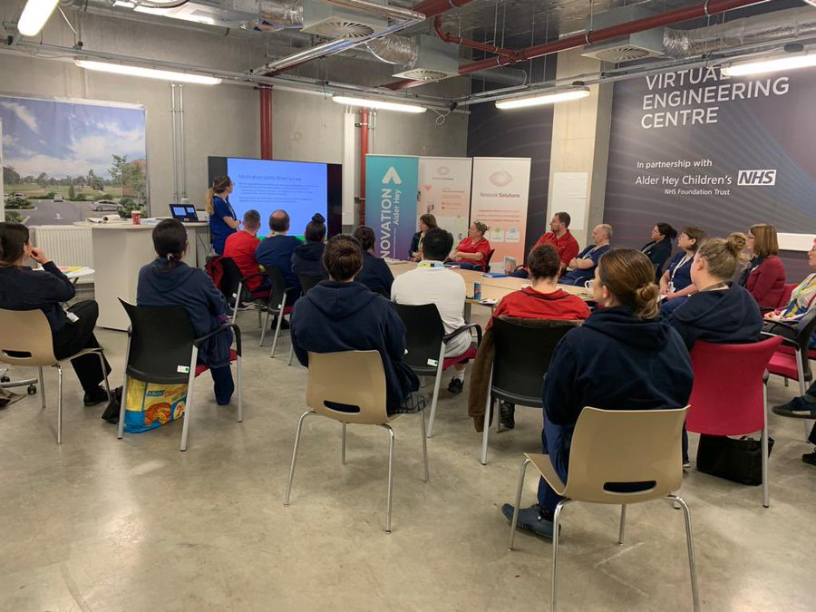
Improving together; sharing learning
Medication Safety Collaborative
Notes:
Our medication safety collaborative is a group of multidisciplinary staff that meet regularly to understand their data, develop change ideas and share learning on improvements that have been made, the difference being made and how this could be adapted/adopted across the organisation.

Slide 15
Thank You for Listening Any Questions?

